Slide 1
Chapter 10: Management, Leadership, & Ethics
-- Dr. L. Daniel Otero, Florida Institute of Technology --
Session III: Leadership and Ethics

Slide 2
Session’s Agenda
Leading the Design Effort
  Personality Traits and Leadership
  Personality Dimension
  Traits of Effective Leaders
  Ethical Leadership
  Power
Key Leadership Skills
  Communication
  Networking
  Motivation
  Negotiation
Ethics in Software Design
  Public and Product Principles
  Judgment Principle
  Management Principle

Slide 3
Leading the Design Effort
Leadership plays a key role in the success or failure of complex projects.
  Therefore, it is necessary to cover important concepts related to leadership in the design effort.
The field of leadership is one that has been researched by academicians and practitioners for many years.
  There is an extensive body of knowledge and literature related to this field.
This session highlights key leadership concepts that are relevant to our study of software designs.
  A significant part of the material covered in this section was gathered from [1]; therefore, the author refers the readers to this work for more detailed explanations of leadership concepts.

Slide 4
Leading the Design Effort
- Personality Traits and Leadership -
Traits are personal characteristics that help to describe a person. For example:
  Highly sociable trait: This trait is present in someone that has the ability to communicate well with others and start friendly conversations with unknown people
  Achievement trait: This trait is present in someone that works hard and tends to go the extra mile to complete assigned tasks
The combination of traits that a person has defines that person’s personality
  Personality significantly affects our decisions.
    For example, a highly sociable person with an achievement trait is expected to make decisions such as volunteering to make presentations to clients.
  Given that a good decision-making ability is a major part of being an effective leader, it is important to understand the relationship between traits, personality, decision-making, and leadership.

Slide 5
Leading the Design Effort
- Personality Dimensions -
Researchers have identified five personality dimensions to categorize groups of traits.
  The objective is to be able to classify someone’s personality into one of these dimensions.
  The five dimensions are:
    agreeableness,
    surgency,
    adjustment,
    conscientiousness, and
    openness to experience.
    NOTE: Although called by different names by various researchers, we will refer to [1] and call them the Big Five Model of Personality.
  Let’s describe each of the five personality dimensions…

Slide 6
Leading the Design Effort
- Personality Dimensions -
The agreeableness dimension contains traits that are related to getting along with people.
  Individuals that are strong in agreeableness are friendly, sociable, and compassionate.
The surgency dimension corresponds to personalities that are dominant (i.e., want to be in control), enjoy competition, and are willing to confront others, among other things.
  Individuals who are weak in surgency are typically followers.
The adjustment dimension is related to emotional stability.
  Individuals who are strong in this dimension are considered stable people who are in control of themselves, positive minded, and react well under pressure.
  Those that are weak in adjustment are considered unstable, and typically are characterized by being negative and perform poorly under pressure.
The conscientiousness dimension contains traits related to achievement.
  Individuals that are strong in this dimension are those that are willing to work extra hours and make sacrifices to reach the assigned objectives.
The openness to experience dimension is related to individuals that are flexible to change, open minded, and attempt enjoy trying new things.

Slide 7
Leading the Design Effort
- Personality Dimensions -
Understanding these dimensions is important because researchers have found varying degrees of correlations between leadership and each of the five personality dimensions.
  For example, [2] analyzed over 70 prior studies to determine correlations between the five personality dimensions and leadership.
  Results showed that the surgency dimension was the highest with a 0.31 correlation.
    This means that traits corresponding to surgency can be used, to some extent, to describe leadership.
    The second highest was conscientiousness with a 0.28 correlation, followed by openness to experience with 0.24, and agreeableness with 0.08.

Slide 8
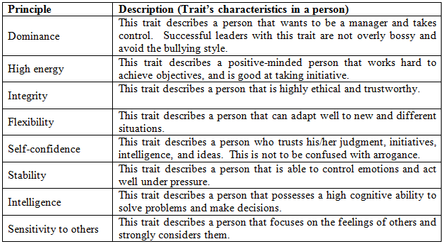
Leading the Design Effort
- Traits of Effective Leaders -
An approach to studying personality dimensions is to investigate common individual traits that effective leaders possess, without grouping traits into personality dimensions.
Some of the most important traits are:
Notes:
As already stated, personality dimensions are defined by groups of traits and can provide an understanding of leadership in individuals. A different approach to studying personality dimensions is to investigate common individual traits that effective leaders possess, without grouping traits into personality dimensions.

Slide 9

Leading the Design Effort
- Ethical Leadership -
Ethics can be defined as a set of moral principles that facilitates the process to distinguish between right and wrong behavior.
Ethical behavior positively correlates with leadership effectiveness [3].
  It is well known that one of the best ways to lead is by example.
  An ethical leader sets the tone for employees to conduct themselves ethically.
  Being an ethical leader can be very challenging due to the risk of rejection or loss associated with ethical decisions.
    To overcome this challenge:
      Focus on a higher purpose while going through the decision process that involves moral behavior.
      Find support from other ethical people (e.g., friends, family, or co-workers).
  Most companies have their own internal documents that describe expected ethical behavior from employees.
    It is very important for leaders to conform to these guidelines, and discuss them with employees.
Notes:
Focus on a higher purpose while going through the decision process that involves moral behavior.
For example, assume that the design lead of a major top secret software project is approached by a foreign citizen with a proposition to sell the software design and other important documents to an enemy country. If focused on the safety of the people (i.e., the higher purpose), then ethical values will provide the answer of not accepting the offer and reporting the foreign person to the authorities.

Slide 10

Leading the Design Effort
- Power -
The potential influence that leaders have over others is called power.
“Potential” means that it is actually the perception of power, and not the power itself, that influences followers.
The two main sources of power are position power and personal power.
  Position power is related to hierarchical position levels (higher levels = higher power)
    Example: The president of a software company has more potential power than any other employee in the company because of position power.
  Position power allows managers to influence employees in order to reach planned objectives.
    Reward Power is a type of position power.
      Managers can influence employees with something of value to them (e.g., performance evaluations).
    Coercive power is another type of position power
      Managers can influence others by the idea of punishment and withholding of rewards.
Notes:
Leading is about influencing others.
REWARD POWER: Employees will be influenced to complete their corresponding assignments because of their manager’s reward power to provide good performance evaluations.
COERCIVE POWER: Employees can be influenced to complete their corresponding assignments because of their manager’s coercive power to provide bad performance evaluations and withhold salary increases

Slide 11

Leading the Design Effort
- Power -
  Personal power relates to the potential influence that a person’s behavior has to influence others.
    Being positive, assertive, and hard worker are some of the characteristics that increase personal power.
  There are various types of personal power.
    The expert power is based influencing others on a leader’s skill and knowledge.
      For example, being an expert in developing architectural designs will influence others to follow the expert.
      The expert power of an individual gets stronger as people with similar expertise levels become fewer.
    The connection power refers to the ability of a person to influence others because of the person’s relationships with influential people.
Notes:
Leading is about influencing others.

Slide 12

Key Leadership Skills
- Communication -
Good communication skills are essential for effective leadership.
  A high % of a managers’ time is spent in communications.
Leaders can influence and establish productive relationships with others through communication.
Truly effective communication occurs when the information passed is equally and fully understood by all parties.
  Advise:
    Plan in advance the message that needs to be conveyed.
    The goal of the message needs to be clearly understood.
    Think about the best timing to convey the message, how will the message be delivered (e.g., oral, written), and where (e.g., company’s auditorium, employee’s office, etc.)

Slide 13
Key Leadership Skills
- Communication -
Effective oral communication can be challenging (and often takes much practice).
  Have a process in place so that focus can be placed in the individual elements of the process.
  Five-step process for effectively sending oral messages [1]:
    (1) Develop a rapport.
      Try establishing a good relationship with the receiving party; begin small conversations related to the message.
    (2) Clearly state the objective of the message.
    (3) Actually transmit the message effectively.
    (4) Perceive the receivers’ understanding of the message.
      It is important that the message was well understood; otherwise its objectives were not achieved.
      This can be accomplished by asking direct questions, or reading the receiver’s expressions.
    (5) Get a commitment from the receiver.
      Only if the goal is to influence the receiver to accomplish a task (e.g., design document)
      The leader must be convinced that the receiver is capable of completing the task by its deadline.

Slide 14

Key Leadership Skills
- Communication -
Another type of communication is written communication.
  This type of communication is now more important than ever, and it is mainly attributed to the e-mail technology.
The key elements for effective written communication are content and structure.
  The message must be structured in such a way that the information it intends to transmit (i.e., content) is clearly described, and the flow of information is smooth and easy to follow.
It is critical for the communicator to clearly understand the intended objective of the message before writing it. Some advise:
  Make an outline with the main points that need to be transmitted.
  Avoid including unnecessary information. Messages must be kept short, simple and to the point.
Writing is a skill! It takes effort and practice to become good at it.
  Have others review your work so that you can learn from their feedback.
Notes:
Making an outline also helps to establish an appropriate flow for the message, which is necessary for a clear understanding of it.

Slide 15

Key Leadership Skills
- Networking -
Networking can be defined as a skill that focuses on building relationships with others through effective communications.
Communications and networking skills are closely related to each other.
Networking is particularly important for leadership because it facilitates the process of meeting objectives.
As with any skill, networking can be improved with practice.

Slide 16
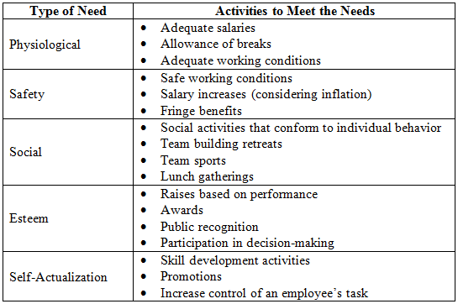
Key Leadership Skills
- Motivation -
There exists a positive correlation between employees’ motivation levels and their productivity.
  A leader must motivate others to work hard to achieve particular project goals.
The hierarchy of needs theory is a motivational theory that describes five types of needs through which employees are motivated.

Slide 17
Key Leadership Skills
- Negotiation -
Negotiation skills are important part of any management job.
Research studies have resulted in various sets of guidelines that can help to improve a person’s negotiation skills.
  One such set of guidelines is called principled negotiation
Principled negotiation is composed of four guidelines.
  (1) Separate the people from the problem.
    This principle helps to keep the focus on the problem at hand rather than on interpersonal issues.
  (2) Focus on interests rather than positions.
    This principle helps to keep the focus of the negotiation on the interests of people rather than their positions.
  (3) Generate options before trying to reach an agreement.
    This principle promotes creativity and reminds the negotiating parties to brainstorm to find various potential solutions that can be brought to the negotiation.
  (4) Insist on using objective criteria.
    This principle promotes decision-making based on reasonable standards rather than on subjective ones.

Slide 18
Ethics in Software Design
Engineers must abide to the highest possible standards when developing software systems
  Helps to make the software engineering profession beneficial and highly respected.
  Engineers have the responsibility to public welfare, including health and safety.
Various principles of ethics collectively ensure that professionals in the software engineering field adhere to high-levels of ethical conduct.
The IEEE-CS/ACM organizations developed a Software Engineering Code of Ethics (SECE) [4] as the standard set of ethical guidelines that engineers must adhere to.

Slide 19
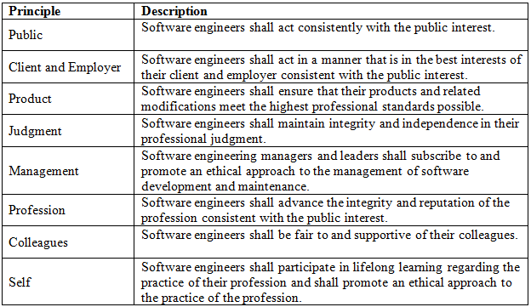
Ethics in Software Design
Principles of Ethics in Software Engineering [4]

Slide 20
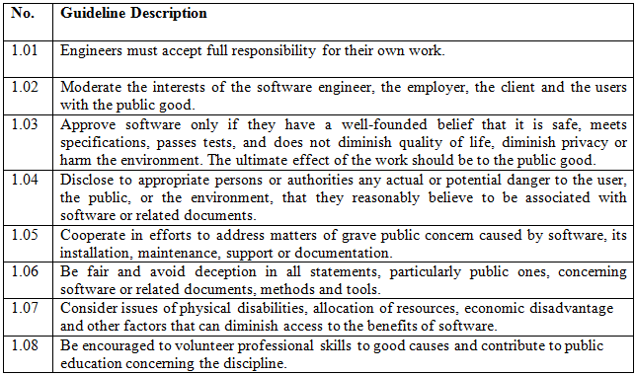
Ethics in Software Design
- Public and Product Principles -
The public principle state that software engineering professionals must:
  Take responsibility for their own work
  Ensure that their work positively affects the public good
  Strive for high quality within acceptable cost and schedule thresholds

Slide 21
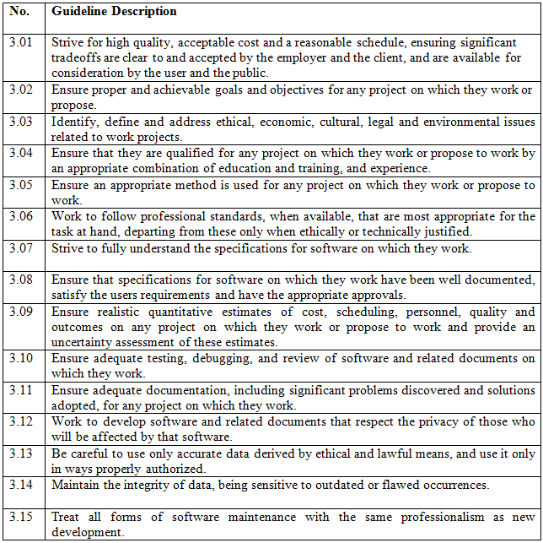
Ethics in Software Design
- Public and Product Principles -
Guidelines related to the product principle

Slide 22
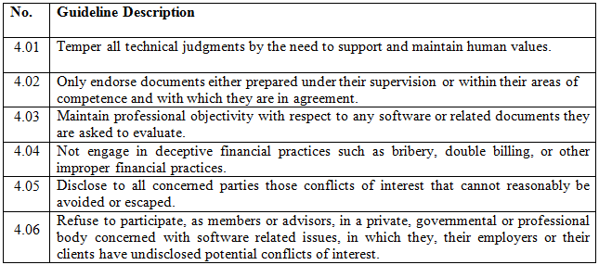
Ethics in Software Design
- Judgment Principle -
The judgment principle deals with maintaining integrity in professional judgment.
  Integrity and moral values of a person plays a major role when making judgment calls.
Guidelines related to this principle are:

Slide 23
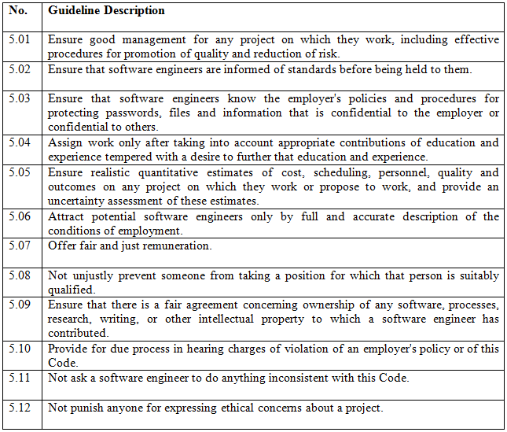
Ethics in Software Design
- Management Principle -
Guidelines related to the management principle

Slide 24
Summary
In this session, we presented:
  Key concepts to leading the design effort
    Personality Traits and Leadership
    Personality Dimension
    Traits of Effective Leaders
    Ethical Leadership
    Power
  Key leadership skills
    Communication
    Networking
    Motivation
    Negotiation
  Key principles of ethics in software design
    Public and Product Principles
    Judgment Principle
    Management Principle

Slide 25

Questions?

Slide 26
References
[1] Lussier, Robert, and Christopher Achua. Leadership: Theory, Application, & Skill Development. 4th. Cengage Learning, 2010.
[2] Judge, T. A., R. Ilies, J. E. Bono, and M. W. Gerhardt. "Personality and Leadership: A Qualitative and Quantitative Review." Journal of Applied Psychology 87, no. 4 (2007): 765-768.
[3] Veiga, J. F. "Special Topic Ethical Behavior in Management, Bringing Ethics into the Mainstream: An Introduction to the Special Topic." Academy of Management Executive 18, no. 2 (2004): 37-38.
[4] IEEE Computer Society. "Software Engineering Code of Ethics and Professional Practice." 2010. http://www.computer.org/portal/web/certification/resources/code_of_ethics.

